Slide 1
Ads Analysis & Clustering Grocery Items
Final presentation
Group 1
Hoang Thy Vo
Preethi Thimma Govarthanarajan
Zenobia Adnan Panvelwala
Chaithra Lakshmi Sathyanarayana
Lishan Zhu
Gurleen Dhillon

Slide 2
Ads analysis

Slide 3
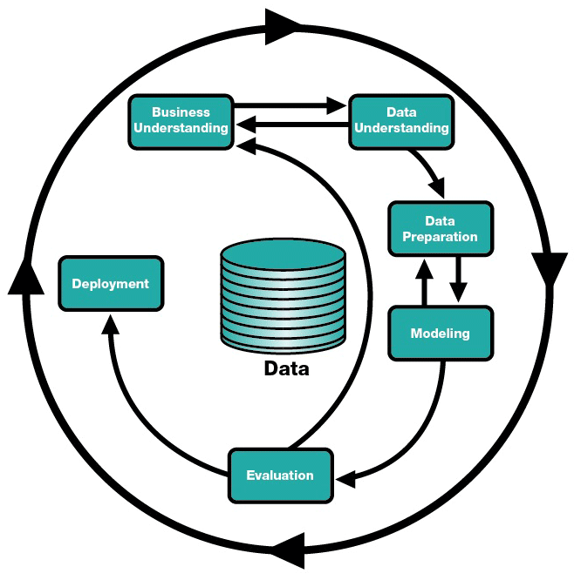
Review
In the Mid Term Presentation, we focused on:
Business Understanding of the problem
Data Understanding, Preparation, and Visualization
Data Exploration
Modeling Research:
Linear Regression
GAM
ARMA
Apply simple GAM and ARMA model to 1 group of data.

Slide 4
From the midterm review to now
From the midterm review to now:
Fit GAM and ARMA models to the whole 40 ads groups
Tuning parameters
Evaluation of the results
Clustering the ads group with a fixed cluster number of 3
Deployment of the solution

Slide 5
Clustering ads group
Ads clustered based on following attributes:
Click-through-rate (CTR)
Conversion rate (CVR)
Average daily profit
Goal: evaluate which ads were similar in terms of each of the above attributes

Slide 6
Clustering ads group - Implementation
We chose k=3 based on how we would like to classify them:
Highly-targeted ads (high CTR and CVR)
Moderately-targeted ads (moderate CTR and CVR)
Untargeted/poorly-targeted ads (low CTR and CVR)
How does each ad group correlate with profit?

Slide 7
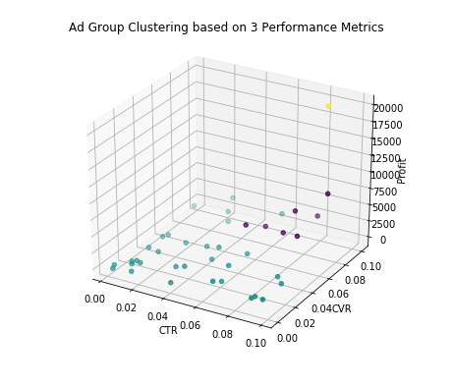
Clustering ads group - Result

Slide 8
ARMA (Autoregressive-moving-average)
ARMA model helps us to understand the serial correlation present within a statistically stationary time-series dataset.
An autoregressive model uses its own historical behaviours as input to capture effects such as momentum and mean-reversion in trading while a moving average model is used to characterise "shock" information to a series. An ARMA model tries to combine both these aspects in modelling a time series dataset.
One of the key features of ARMA model is that it is stingy and redundant in its parameters and often require fewer parameters than an AR(p) or MA(q) model alone.
An ARMA model does not take into account the volatility clustering in a time-series dataset.
Thus we can say that ARMA model uses dataset with “strict stationarity”.
Notes:
A stationary time series has constant mean, variance, autocorrelation etc over time and uses this constant property to predict future values.
“Volatility clustering is the tendency of large changes in prices of financial assets to cluster together, which results in the persistence of these magnitudes of price changes.”

Slide 9
ARMA – Implementation and Tuning
statsmodels.tsa.arima_model.ARMA() function was used for ARMA implementation.
Finding the order (p, q) of ARMA model is very important
Use AIC values across a range of (p, q) orders and then applied Ljung-Box test to determine if the best fit was achieved for the dataset.
Akaike information criterion (AIC) is an estimator that aids in estimating the quality of each model under analysis. Lower the AIC value, better the model.
AIC value increases with the number of parameters and decreases if negative log-likelihood increases thereby penalizing models that overfit data.
statsmodels.stats.stattools.jarque_bera() function was used to test the normality of a dataset. Probability value (pr-Value) greater than 0.05 signifies that the residuals are independent and white noise and ARMA model provides a good fit.

Slide 10
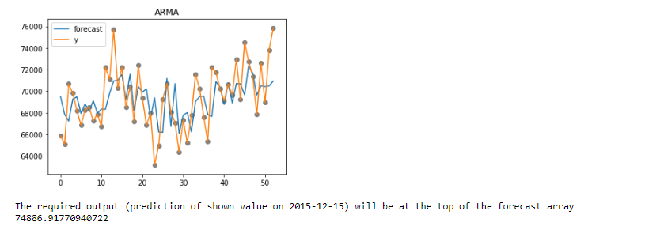
ARMA implementation - Ad group 1

Slide 11
ARMA – Evaluation
We obtained probability-value less than 0.05 for all our individual ad groups.
Since our time-series dataset had volatility clustering, it was not strictly stationary, making it unfit for ARMA model.
On further trying to predict the future “shown values” for an ad group, we received ValueError: The computed initial AR coefficients are not stationary for ad groups 16, 6, 19, 20, 12 and 38.
This error is found only if non-stationary or non-invertible starting parameters are found.
ARMA by default imposes stationarity on the parameter estimates.
Solution: transparams = false for fitting the data which still resulted in ValueError.
Another solution to fit the non-stationary data in ARMA is to choose our own parameters for p and q.
This can lead to Data snooping and Overfitting.
Notes:
Need to emphasize that the dataset of this project is not suitable for ARMA

Slide 12
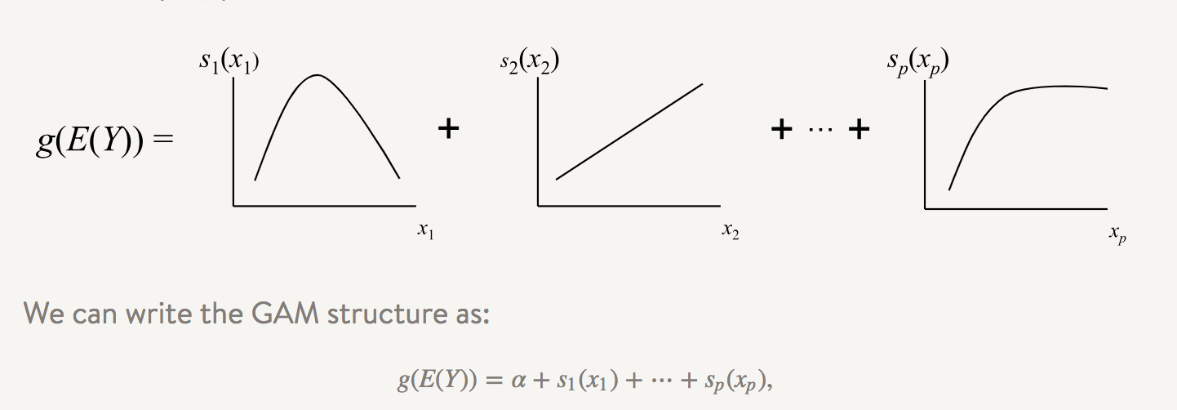
GAM
Why we select GAM?
Easy to interpret (generalized linear model).
Flexibility and Automation: can capture common nonlinear patterns that a classic linear model would miss, predictor functions are automatically derived during model estimation. We don’t have to know up front what type of functions we will need
Regularization of predictor functions helps avoid overfitting: control smoothness of the predictor functions
Notes:
In general, GAM has the interpretability advantages of GLMs where the contribution of each independent variable to the prediction is clearly encoded. However, it has substantially more flexibility because the relationships between independent and dependent variable are not assumed to be linear. In fact, we don’t have to know a priori what type of predictive functions we will eventually need. From an estimation standpoint, the use of regularized, nonparametric functions avoids the pitfalls of dealing with higher order polynomial terms in linear models. From an accuracy standpoint, GAMs are competitive with popular learning techniques.

Slide 13
GAM – Implementation and Tuning
pygam.LinearGAM() model for regression problem
Find the right set of hyperparameters for the LinearGAM model using grid search technique
gam = LinearGAM(n_splines=10).gridsearch(X, y, lam=np.logspace(-3,3, 6), n_splines=np.arange(40))
pygam package supports auto-tuning
Tuning hyper parameters: n_splines (5, 7, 10, 20, 30, 40, 45) and lambda (1.e-03, 1.e-02, 1.e-01, 1.e+00, 1.e+01, 1.e+02, 1.e+03)
n_splines: A spline curve is a is piecewise polynomial curve, i.e., it joins two or more polynomial curves. The locations of the joints are known as “knots”. N_splines refer to the number of “knots” we place on the curve of data points
Lambda: regularization penalty terms

Slide 14
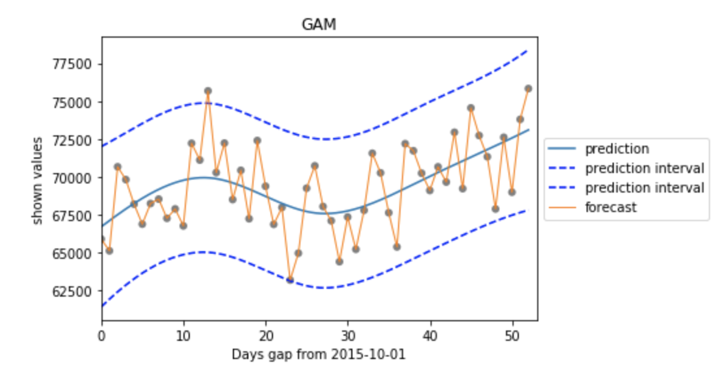
GAM – Evaluation
An adaptation of cross-validation – generalized cross-validation is selected as evaluation method
Evaluation metric: sum of squared error
Tuning and evaluating GAM model for each ads group respectively
For example: ad_group_1 has the best GCV metric as 6709968.990582694 with lambda 0.1 and n_splines 7

Slide 15
Difficulties
Vague descriptions and incorrect interpretation of data fields
Interpreted revenue as gross revenue instead of net revenue
Lacking knowledge of time-series data and regression model for this kind of data
Thinking process: do more research, trial-and-error method
Each team member look into one “potential” model for the prediction problem
Apply the models, evaluate the result

Slide 16
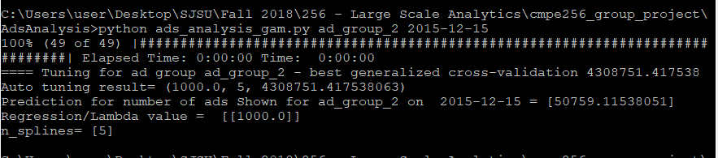
Ads Analysis – Deployment
Company XYZ is a food delivery company which relies significantly on online ads. The requirement of XYZ company is to predict how many ads will be shown on Dec 15th 2015.
For the scope of this project, we have created script for GAM and ARMA algorithm which will be called from the main program depending on the user’s choice of date and ad group.
The client can then,for example use GAM to get the result.
> python ads_analysis_gam.py <ad_group> <prediction_date>

Slide 17
Grocery Items

Slide 18
Review
In the Midterm Presentation, we focused on:
Business Understanding of the problem
Data Understanding, Preparation, and Visualization
Data Exploration
Modeling Research:
K-Means
Hierarchical Clustering
FP Growth for 15 Transactions
Apriori for 5 Transactions

Slide 19
From the midterm review to now
From the midterm review to now:
Generated Association Rules for the dataset using the item name as opposed to item id
Generated Association Rules for the whole dataset for Apriori and used stratified sampling for FP Growth
Finetune the parameters of the models to produce better visuals
Visualized the output of the Association Rules
Clustered the output using open source libraries
Evaluation of the results
Deployment of the solution

Slide 20
Association Rule Mining and Graph-based clustering
FP Growth and Apriori are both algorithms that implement Association Rule Mining
FP Growth is recursive reads the dataset twice: the first pass to build the header table and the second pass to build the FP Tree
Apriori is a bottom up approach that uses breadth-first search and a hash tree structure to count the candidate itemsets efficiently
The output of these two algorithms was a dictionary
This dictionary was used to create a networkx graph object. Added the dictionary keys as nodes to the graph object
Then displayed the visualization
Built-in networkx functions used to determine clustering: Strongly connected components, Connected Components, and Communities of the graph to determine clusters
Notes:
nx.clustering() —> finds the clustering coefficients for nodes.
nx.connected_components() —> generated the connected components
If you want the largest connected component can use the max(nx.connected_component(G), key=len) —> this Is for undirected graphs
3) from networkx.algorithms import community —> functions for computing and measuring community structure. Using partition can compute communities based on centrality notions.
The Girvan–Newman algorithm detects communities by progressively removing edges from the original network. The connected components of the remaining network are the communities. Instead of trying to construct a measure that tells us which edges are the most central to communities, the Girvan–Newman algorithm focuses on edges that are most likely "between" communities.
The algorithm's steps for community detection are summarized below
The betweenness of all existing edges in the network is calculated first.
The edge with the highest betweenness is removed.
The betweenness of all edges affected by the removal is recalculated.
Steps 2 and 3 are repeated until no edges remain.

Slide 21
Apriori - Implementation
association_rules = apriori(item_transactions, min_support=0.00045, min_confidence=0.65, min_lift=1, min_length=2)
The output was in the form of a dictionary where the values for the key was a list of items that had strong association with the key item. The dictionary keys were added as nodes to the networkx graph object
Using Connected Components we generated 48 ‘Clusters’ → each item is own cluster
> nx.connected_components(G)
With Strongly Connected Components we generated 19 Clusters:
> x = nx.strongly_connected_components(G)
Using Communities produced 2 Top-Level Communities and 3 Next-Level Communities:
> communities_generator = community.girvan_newman(G)
> top_level_communities = next(communities_generator)
> next_level_communities = next(communities_generator)
Notes:
Support == how frequently the itemset appears in the dataset. (0.00045 * ~40,000) = 18 ; 0.045% of the transactions must include those items in a transaction together
---
nx.clustering() —> finds the clustering coefficients for nodes.
nx.connected_components() —> generated the connected components
If you want the largest connected component can use the max(nx.connected_component(G), key=len) —> this Is for undirected graphs
3) from networkx.algorithms import community —> functions for computing and measuring community structure. Using partition can compute communities based on centrality notions.
The Girvan–Newman algorithm detects communities by progressively removing edges from the original network. The connected components of the remaining network are the communities. Instead of trying to construct a measure that tells us which edges are the most central to communities, the Girvan–Newman algorithm focuses on edges that are most likely "between" communities.
The algorithm's steps for community detection are summarized below
The betweenness of all existing edges in the network is calculated first.
The edge with the highest betweenness is removed.
The betweenness of all edges affected by the removal is recalculated.
Steps 2 and 3 are repeated until no edges remain.
[Skip]

Slide 22
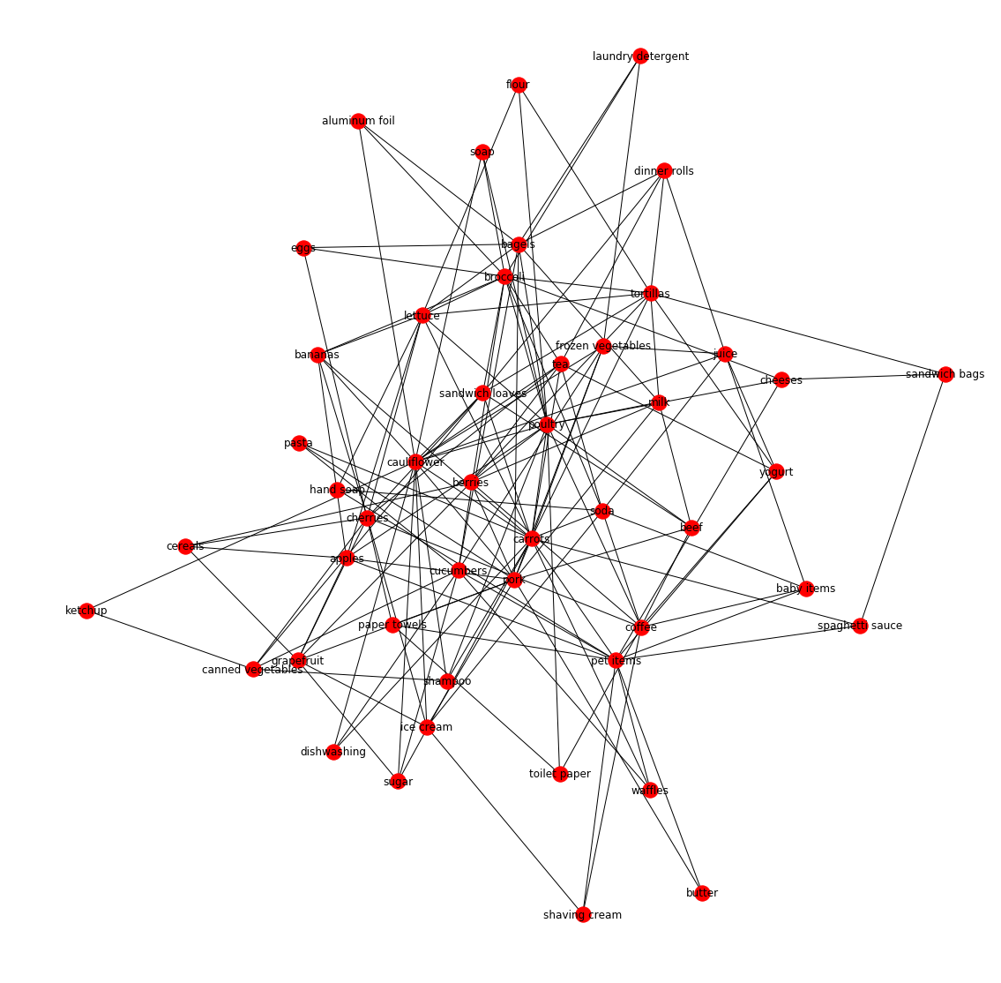
Apriori - Result
For Apriori the built in functions did not provide very clear clusters, which could be seen on the graph as well. Since there are only 48 items within the dataset there is a strong likelihood that one item is related to any item on the dataset in some way
Not suitable for problem at hand

Slide 23
Difficulties
Since Apriori is not helpful for our problem in this particular dataset, we moved on with FP Growth…
However, we faced a challenge with runtime in executing the FP Growth Algorithm
Killed:9 signal After about 52 Minutes of runtime → program used too much memory
High CPU Usage: ~99%
High Memory Usage: ~6.45 GB
The association rules were generated in two steps: First the frequent itemsets were generated and then the association rules were generated from those patterns
We learned that generating frequent itemsets in pattern mining is expensive because of the large number of transactions and the size of unique items
Naturally, we considered these approaches:
Reduce number of transactions: apply sampling technique, accept that we can have lower support/frequency
Reduce number of candidate frequent itemsets: prune the candidates based on support and confidence threshold

Slide 24
FP Growth - Implementation
Stratified sampling - sampling on transaction groups defined by user
> n = new_transactions.groupby('user_id').apply(lambda x: x.sample(frac=0.11))
Similarly to Apriori the output dictionary was used to populate nodes and edges of a networkx graph to provide visualization
Using connected components generated 40 Clusters:
> nx.connected_components(G)
Using Communities generated 32 Top-Level Communities and 33 Next-Level Clusters:
> communities_generator = nx.algorithms.community.centrality.girvan_newman(G)
> top_level_communities = next(communities_generator)
> next_level_communities = next(communities_generator)
Notes:
N = 278, for pattern we are looking for items to appear together at least 3 times out of those 278 transactions before they can be added to the tree. Support in this case 1.07 % or 0.0107913669 which is larger than the support for apriori

Slide 25
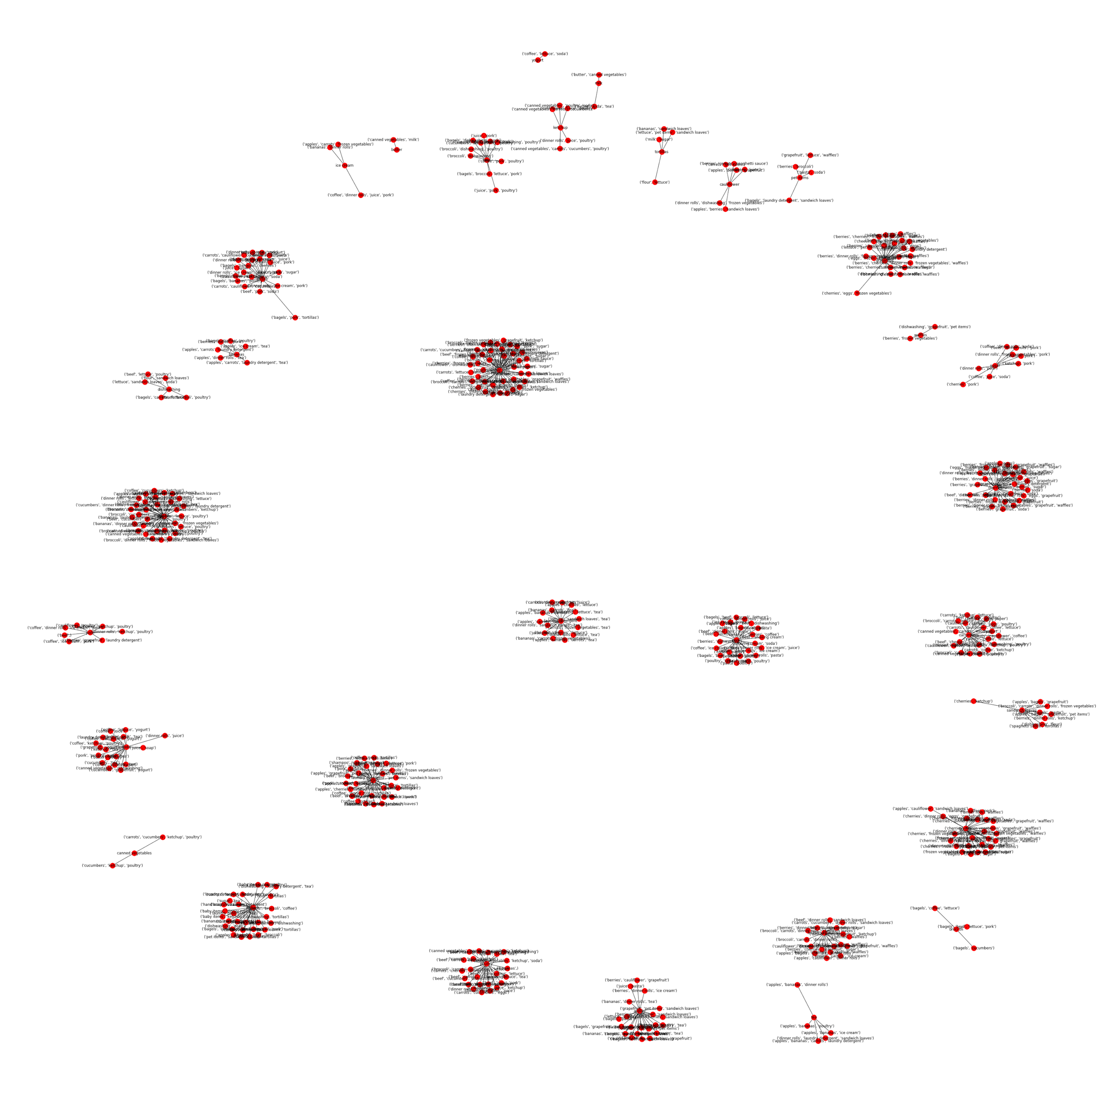
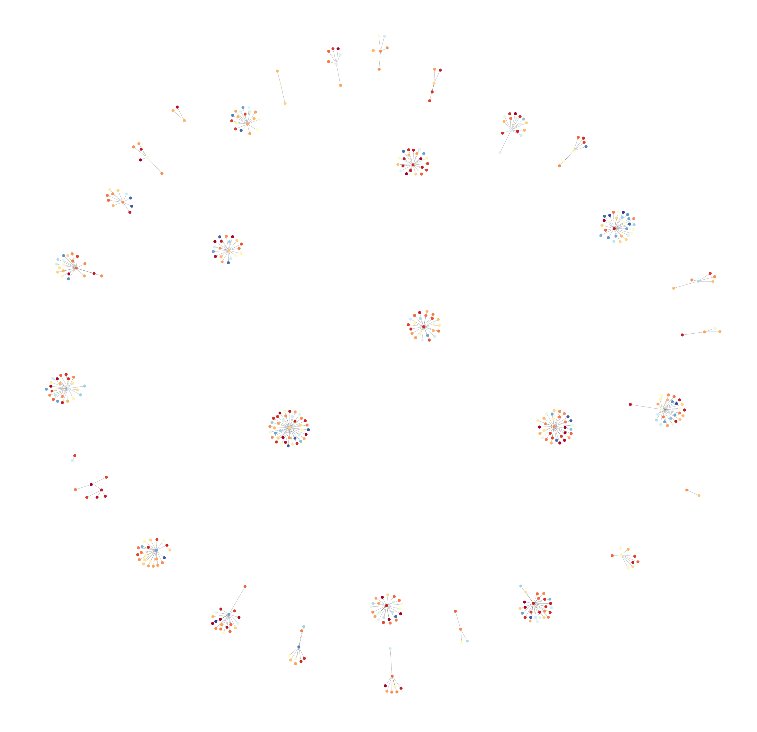
FP Growth - Result

Slide 26
FP Growth – Result
Cluster recommendations based on connected components:
('broccoli', 'carrots', 'frozen vegetables', 'sandwich loaves') ('berries', 'cherries', 'eggs', 'grapefruit') ('coffee', 'ice cream', 'juice', 'pork') ('berries', 'eggs', 'grapefruit') ('coffee', 'juice', 'pork') dinner rolls ('cherries', 'frozen vegetables', 'tortillas') ('carrots', 'cucumbers', 'sandwich loaves') ('carrots', 'sandwich loaves') ('bananas', 'spaghetti sauce') ('frozen vegetables', 'pork', 'sugar') ('broccoli', 'carrots', 'sandwich loaves') ('cherries', 'frozen vegetables', 'sandwich loaves') ('berries', 'cherries', 'eggs') ('cucumbers', 'sandwich loaves') ('sandwich loaves', 'sugar') ('carrots', 'cucumbers', 'frozen vegetables', 'sandwich loaves') ('berries', 'juice') ('broccoli', 'frozen vegetables', 'sandwich loaves') ('berries', 'ketchup') ('beef', 'frozen vegetables') ('carrots', 'poultry', 'sandwich loaves') ('poultry',) ('poultry', 'toilet paper') ('frozen vegetables', 'grapefruit', 'ketchup') ('berries', 'ketchup', 'sandwich loaves') ('laundry detergent', 'lettuce', 'sugar') ('beef', 'frozen vegetables', 'sandwich loaves') ('frozen vegetables', 'laundry detergent', 'sugar') ('berries', 'frozen vegetables', 'laundry detergent') ('cherries', 'grapefruit', 'poultry') ('carrots', 'lettuce', 'sandwich loaves') ('cauliflower', 'dishwashing', 'frozen vegetables') ('carrots', 'cucumbers', 'frozen vegetables') ('coffee', 'ice cream') ('bagels', 'cherries', 'tortillas') ('frozen vegetables', 'ketchup') ('carrots', 'frozen vegetables', 'sandwich loaves') ('berries', 'cherries', 'frozen vegetables', 'grapefruit', 'waffles') ('apples', 'bagels', 'cherries', 'frozen vegetables')

Slide 27
FP Growth vs Apriori Output
In theory, if the given dataset is the same and the parameters are the same the results of the two algorithms should also be the same.
In our case, we were unable to generate association rules for the whole dataset using FP Growth so the sample was smaller, the minimum probability was higher: 0.85 compared to Apriori: 0.65 so the output differed. Not obvious if there was any overlap in association rules.
The output for Apriori was in the following format:
[‘cherries’] —> [‘apples’, ‘dishwashing’, ‘bananas’].
Apriori generated association for single items with n items within the dataset (one-to-many)
Unlike Apriori, FP Growth output contained multiple items as the node/dictionary key:
For instance (‘coffee’, ‘lettuce’, ‘soda’) would be considered as a graph node when supplied to networkx that is associated with item (‘yogurt’), which would be an edge.
The dictionary keys were tuples that could contain more than item
It allows for far more combinations of items and more unique relationships (many-to-many)
This makes sense as to why FP Growth rule generation did not complete for the dataset
Would be difficult to visualize for very large dataset with networkx(with millions of nodes and edges)
FP Growth output when graphed with networkx and clustered did not have as many ‘clusters’ with items on their own like the Apriori result

Slide 28
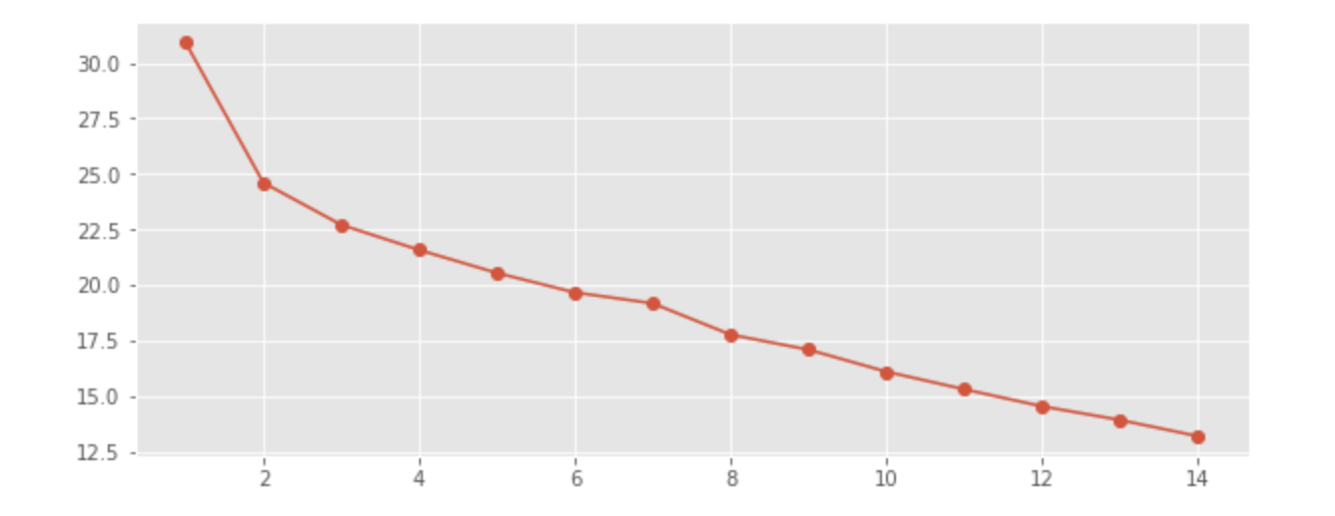
K-means clustering – First attempt
SSE vs K
Back to the mid-review presentation ...
K varies between 2 and 48 (maximum number of features)
No elbow point of determining the optimal of clusters
Solution: apply more data pre-processing or try another model
SSE vs K
Notes:
Create cluster of items frequently bought together
K-means : plot SSE for different values of K - no elbow point
2 Solution: 1. Apply different preprocessing techniques
2. Try another model

Slide 29
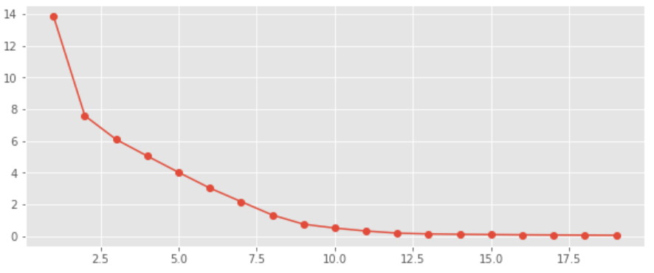
K-means clustering – PCA applied
Solution 1
PCA for dimensionality reduction, number of features varied between 2 to 48
K varied between 1 and 30
Finding the proper number of K is feasible with PCA - look for elbow point
We select PCA components value of 10 (selected by variance explained value) and k of 11
SSE vs K
Notes:
Preprocessing - PCA - for different dimensions and K values
We got elbow point for dimensions 5 to 10
Based on the explained variance value - we select PCA dimensions as 10
We get elbow point at 11
Apply K-means with 11 clusters

Slide 30
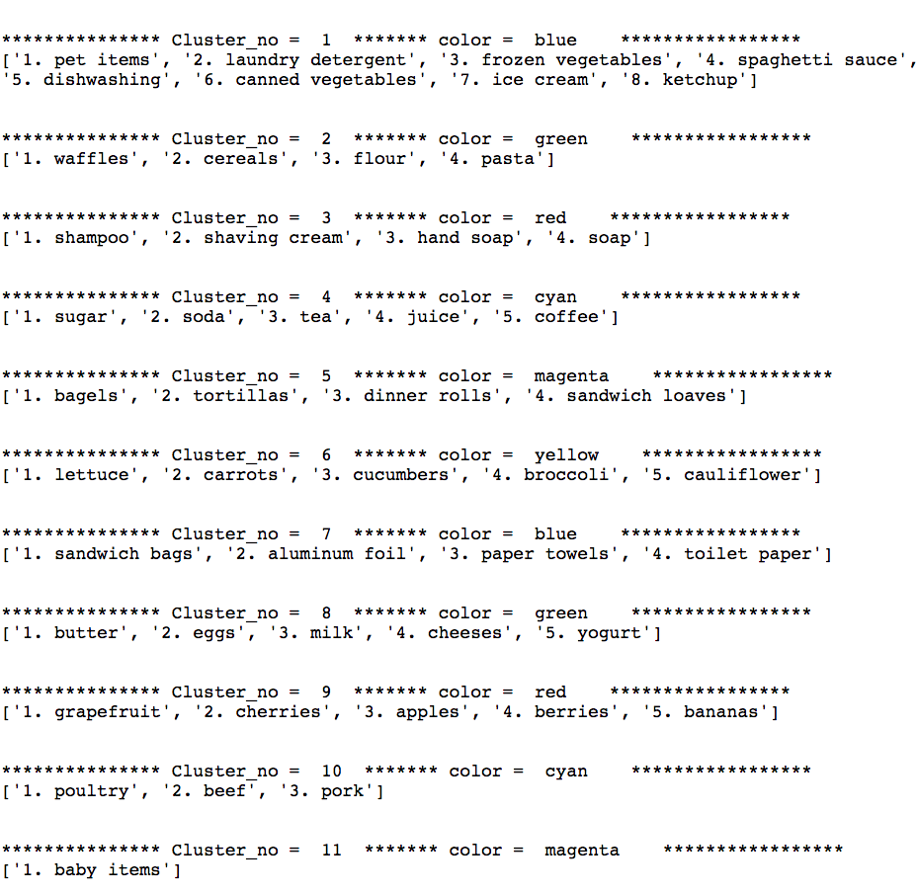
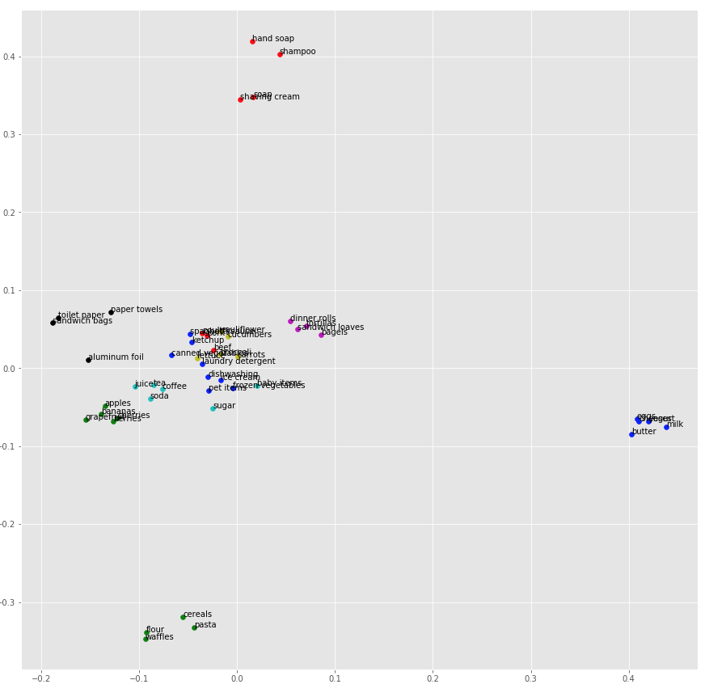
K-means Clustering
K-means Cluster, K=11
2-D Visualization of K-means Clustering
Notes:
First image shows the 11 clusters
2nd image - 2D- Visualization of K-means clustering

Slide 31
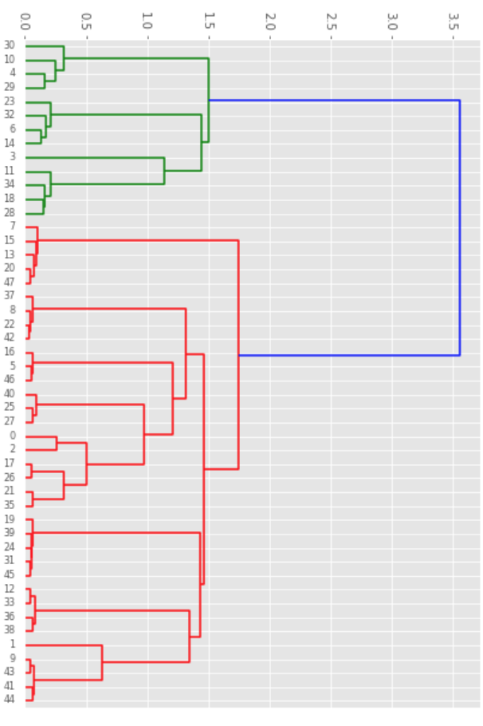
Hierarchical Clustering
Solution 2
Hierarchical clustering : Partitions can be visualized using a tree structure - dendrogram
Agglomerative/Bottom-up approach
Dendrogram
Notes:
As part of 2nd approach: we used hierarchical clustering with Agglomerative bottom-up approach
Dendrogram

Slide 32
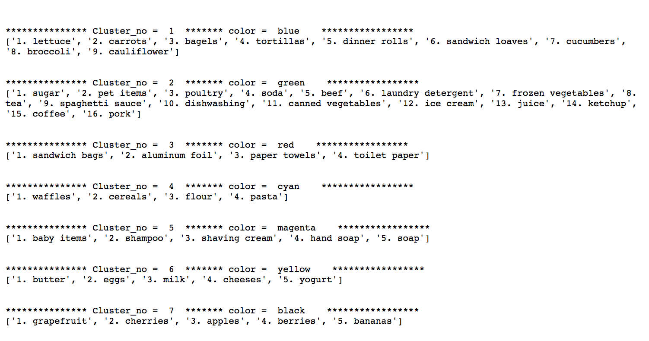
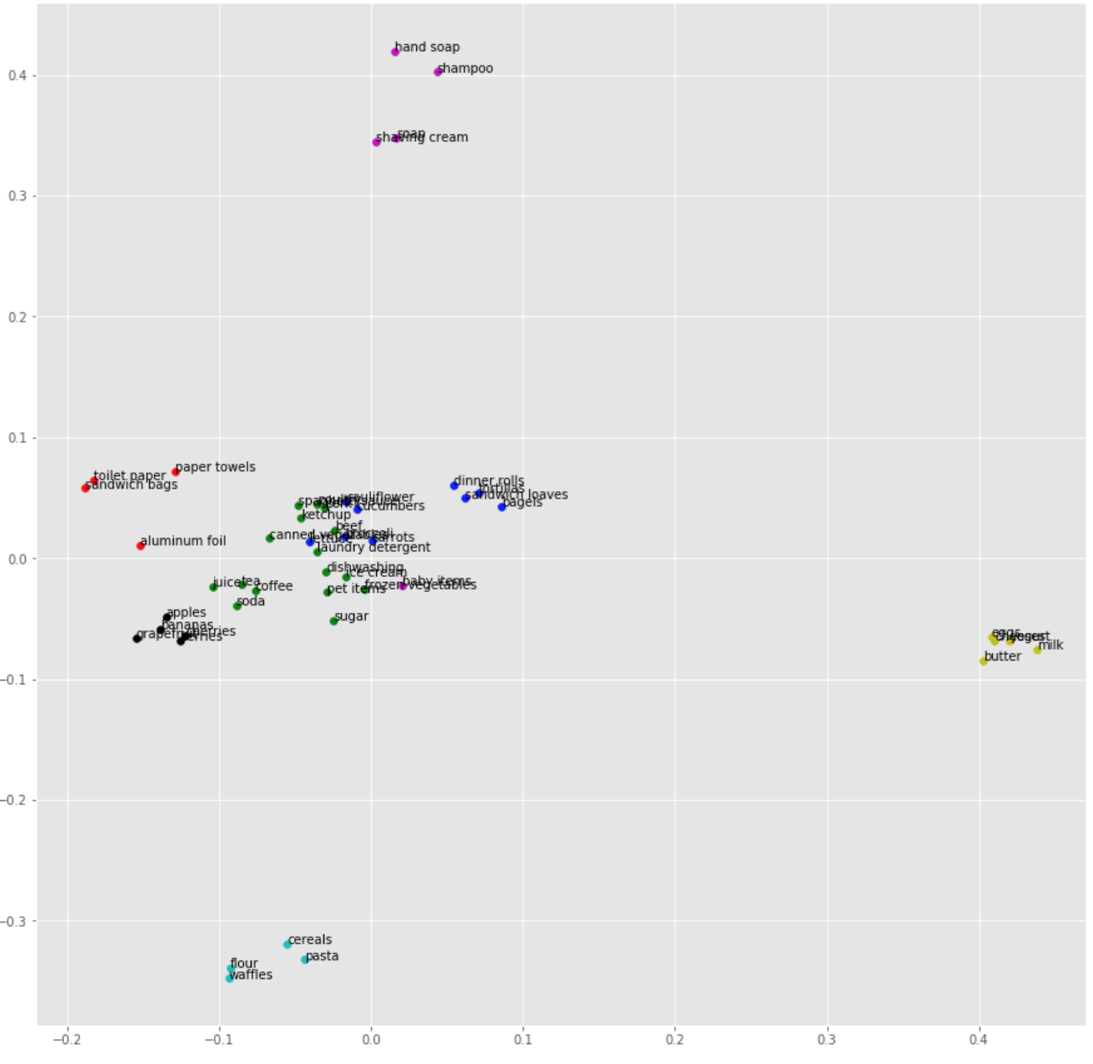
Hierarchical Clustering Result
Hierarchical Clusters, Number Of Clusters = 7
2-D Visualization of Hierarchical Clustering
Notes:
Hierarchical clustering gave 7 clusters
First image shows the 7 clusters
2nd image - 2D- Visualization of K-means clustering

Slide 33
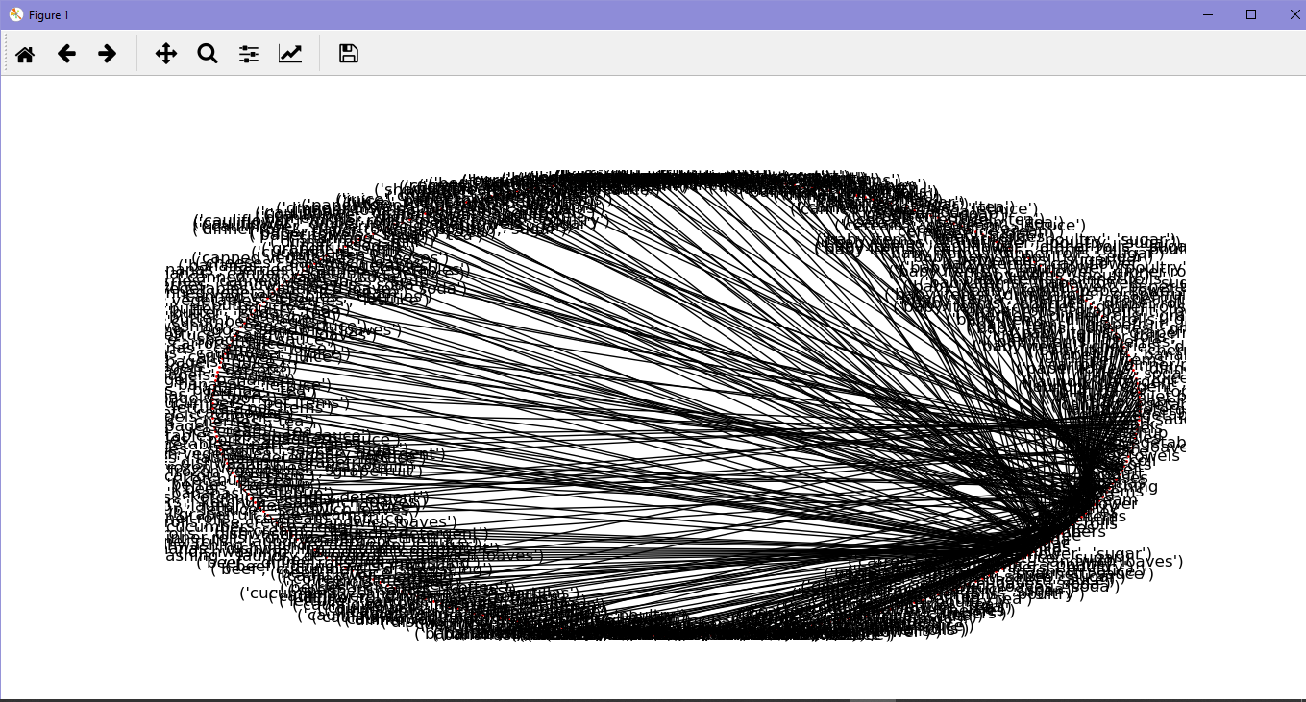
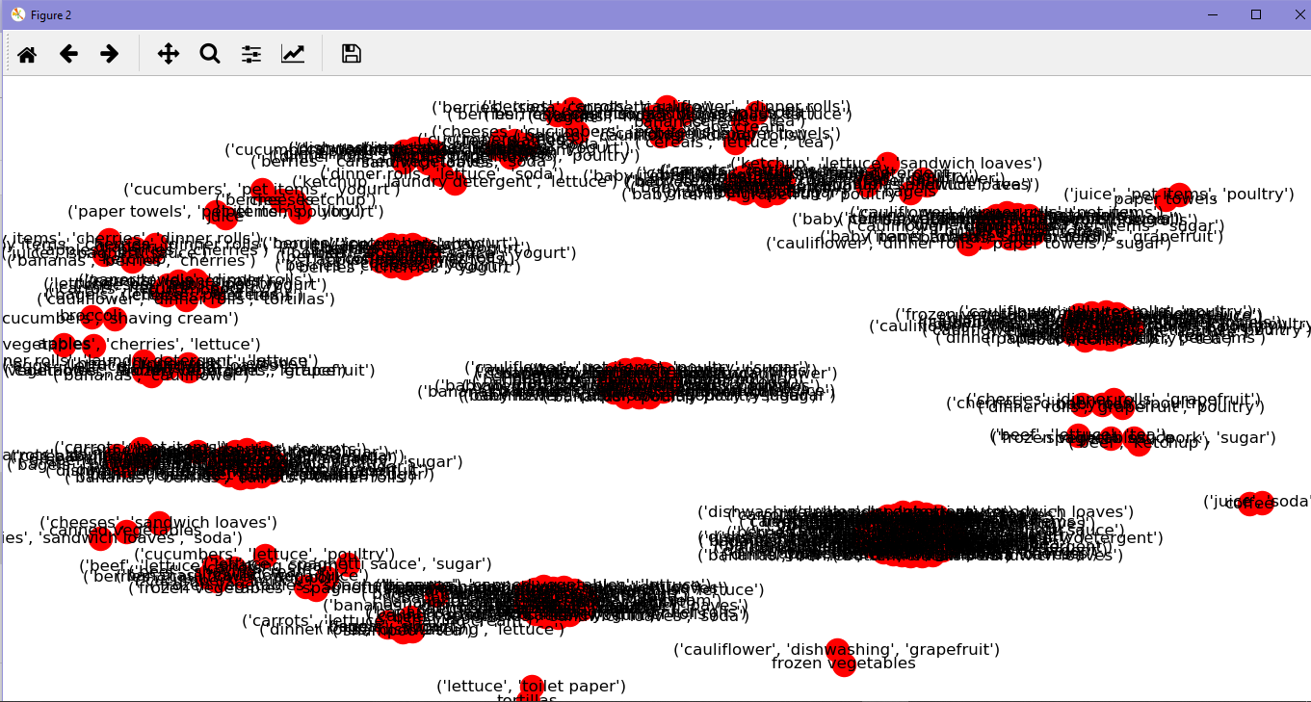
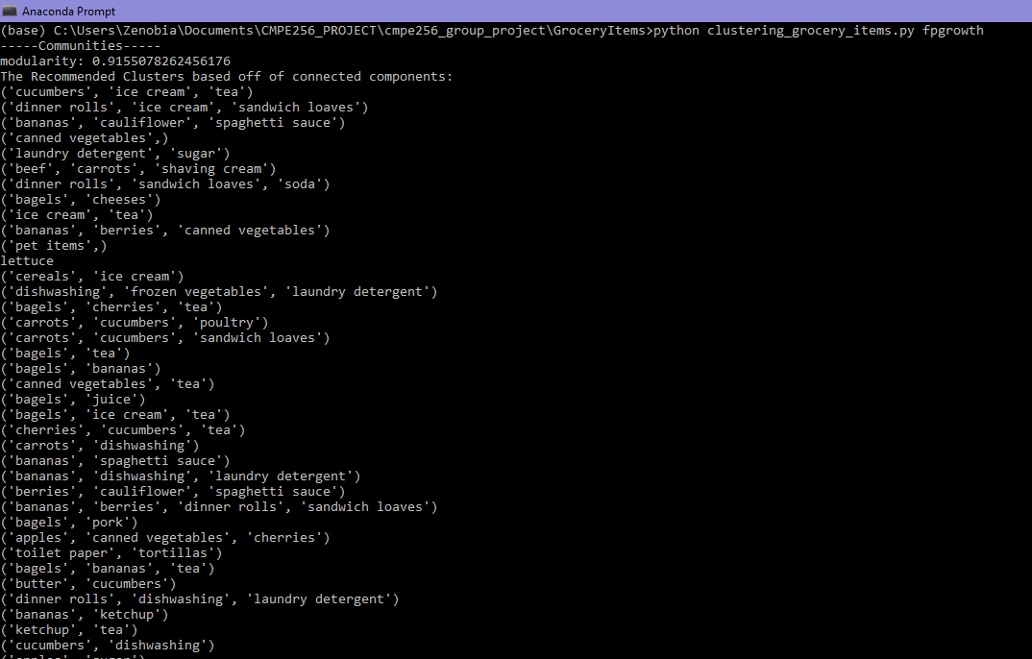
Grocery Items - Deployment
Company XYZ is an online grocery store.They want us to create clusters of products that have the highest probability of being bought together. For the scope of this project, we have created simple application for FP Growth and K-means algorithm which will be called from the main program depending on the user’s choice.
The client can then, for example use FPGrowth to get the result.
Notes:
Simple application to generate clusters with FP-Growth or K-means
The user can select either of these 2
The application runs that algorithm and shows the clusters

Slide 34
References
https://www.lpsm.paris/pageperso/ramacont/papers/clustering.pdf
https://people.duke.edu/~rnau/411diff.htm
https://medium.com/auquan/time-series-analysis-for-finance-arma-models-21695e14c999
https://github.com/statsmodels/statsmodels/issues/3505
https://multithreaded.stitchfix.com/blog/2015/07/30/gam/

